Slide 1

STUDENT EXAMINATION MANAGEMENT SYSTEM
(SEMS)
2010080001 Abhiram K
2010080036 Kapila Vishnu Vamsi
2010080017 Sahasi Korrapati

Slide 2
INTRODUCTION:
Our project is about student exam management system. The main objective of the system is to check the eligibility status of students to allow them to write the final exams.
Our Goal is to modify the existing manual storage of the records of students which will reduce lot of human energy and using computer knowledge to make things smoother and faster simultaneously.
In our code we tried to create a software which takes the inputs as student’s details, paid status, attendance status and checks the student is eligible or not on the criteria we specified.
.

Slide 3
Existing System
The existing system is the old hand, manual written which will have much error
Disadvantages:-
It contains much error because of manual entries.
It takes much time to store and collect the data as we need to write manually every record.
Even though we write the data it is difficult to preserve the data as it needs many shelves to keep the files and fire accidents can destroy every record as we saw many cases like that which destroyed many records.
Records can be manipulated if it is written manually, etc.
Proposed System
The proposed system is written in C language which is easy and efficient to understand by the user. It is much error free than the manual hand written record.
Advantages: -
It is easy to write the code.
It is error free.
It takes less time and is more efficient to use the proposed system.
It can store more records than the existing one within less time.
It is easy to store the data in this system.
Accuracy to work and easy to update information
.

Slide 4
The criteria we specified are that a student is only eligible to give the final exams if and only if his fee payment status is ‘P’ and the percentage of attendance is more than 65%.
We get the status of fee payment when the fees is fully paid ‘P’ and for rest of the cases it is ‘F’. similarly we get the status of result – ‘PASS’ if the student gets greater than or equal to 50% in all the subjects , else the student gets ‘FAIL’ as result. The status of attendance is also achieved by giving number of days present by the student. if the percentage is greater than or equal to 65%, the student is allowed to take the exam.
In the source code the total work is divided into 6 functions.
The functions are:
Get student data.
Display student data.
Check the eligibility of student data.
Accept the marks.
Display the result.
Exit.
.

Slide 5
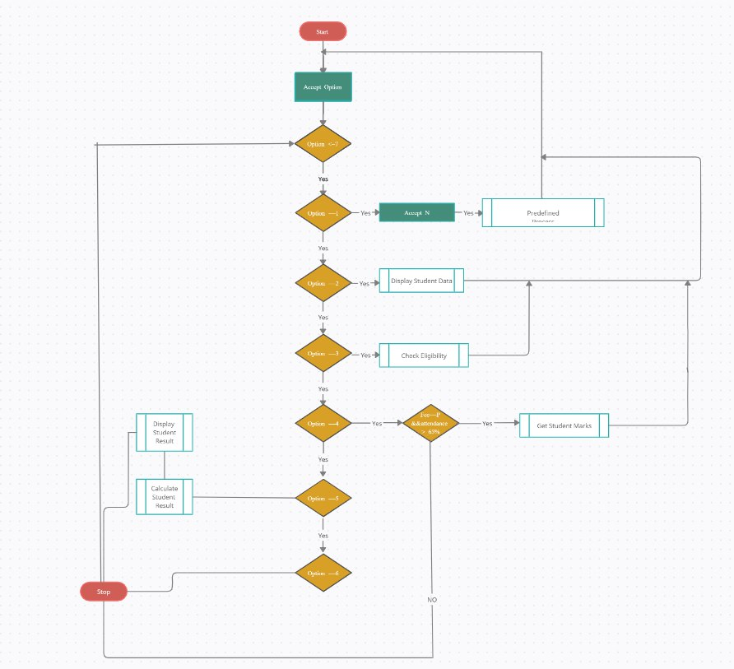
Main function
FLOWCHARTS FOR THE SOURCE CODE :

Slide 6
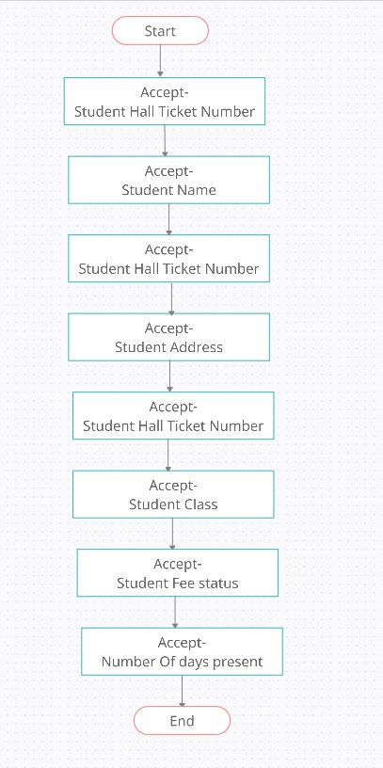
01
Get student data :

Slide 7
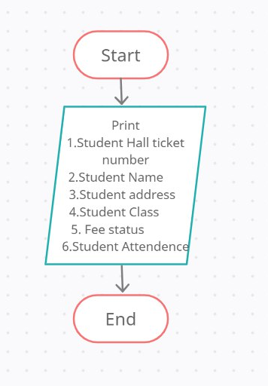
02
Display student data:

Slide 8
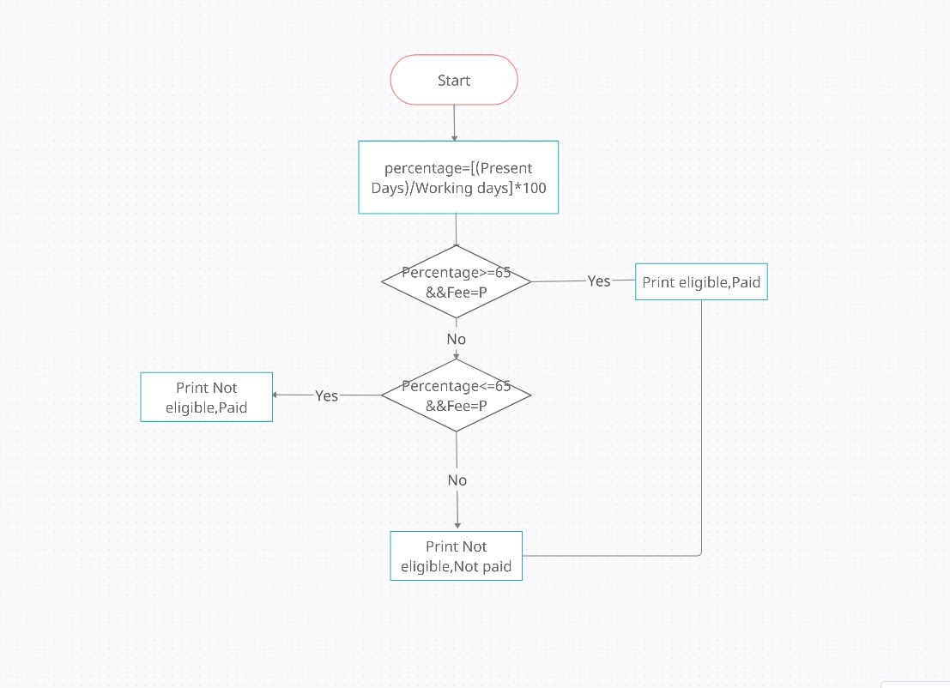
03
Check the eligibility of the student:

Slide 9
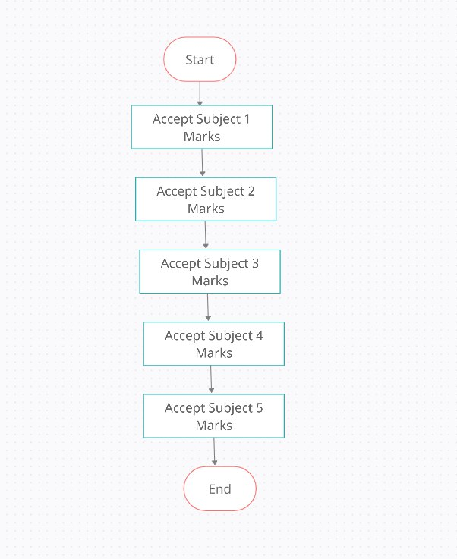
04
Accept the marks :

Slide 10
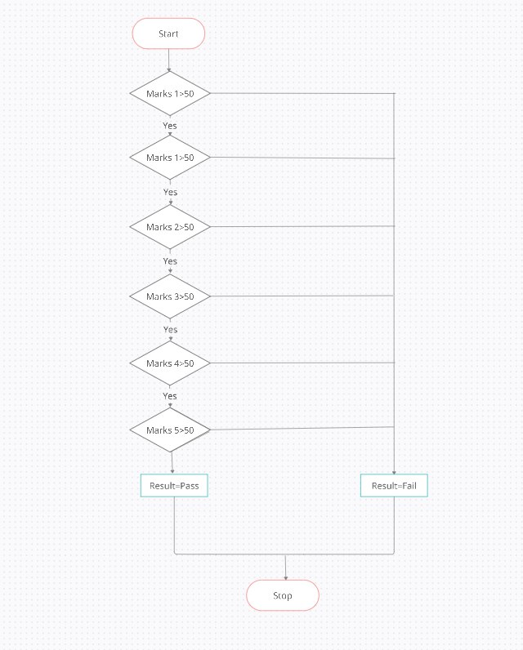
05
Display the result :

Slide 11
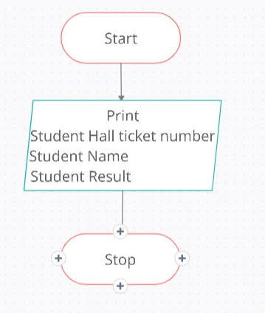
06
Exit :

Slide 12
Conclusion :
Hence a system will be developed which will help to manage the proceduressingle handedly which reduces errors and increase efficiency.
Future Implementations :
In future implementations of this Student Exam Management System project can store data in database (Rows and Columns) by using SQL (Structured Query Language) and using commands like UPDATE, SELECT, DELETE, DROP, INSERT, etc, and by using high level languages like Java and Python which we can get the data of a particular student by just entering student unique ID
Hence a system will be developed which will help to manage the procedures single handedly.

Slide 13
THANK YOU!
We are greatly indebted to the authorities of KL deemed to be university Hyderabad . For providing us the necessary facilities to successfully completion of this project.

